Slide 1
Solar Initiative
Parkland Fuels

Slide 2
Commercial Solar
Difficult area
Highest growth and highest market
Residential
Utility
Potential customers is not a problem
Success highly depends on your business model
Regular Solar
Solar + Storage
Is becoming a more feasible option because of drop in cost for battery storage
Notes:
Alot of analysis has to be done to make it economically beneficial for the customer.
You have to offer an economic benefit for a company to go solar
Plain solar
Some customers might just benefit from plain solar.
Extra energy is curtailed, or sold back to the utility
When you sell back to the utility, depdnding on your region. Net-metering or get 90% credit on your energy, or etc….
Solar + storage
There may be large energy usage outside of peak sun hours
Storage of solar energy will help utilitze that energy later
Also depends on the size of solar installation and the desires of the customer
You basically need a ROI profile

Slide 3
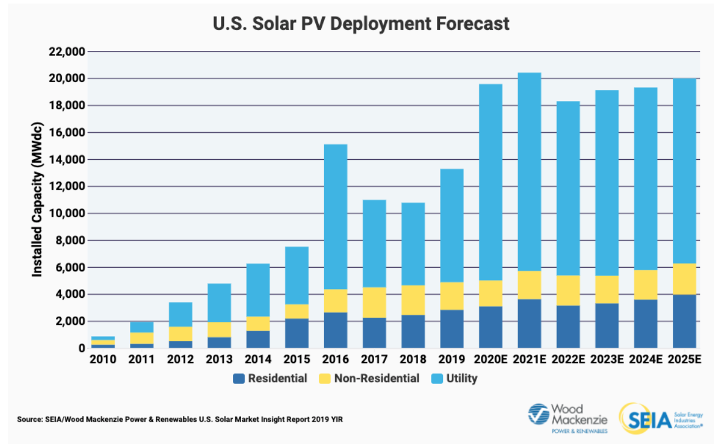

Slide 4
Benefits for Businesses to go Solar
PR
Commitment to sustainability
Electricity Savings
Locked electricity rates
Company has large energy load
In some case, companies are charged for electricity spikes i.e. turning on machinery
Other savings
Solar incentives / Tax Credits

Slide 5
Questions for Businesses
How will you finance your solar panels?
Solar Lease / Loan, PPA, Full purchase
ROI?
How much electricity do you use?
Will solar lower your energy costs?
Will it need to be coupled with energy storage to be economically beneficial?
Based on energy requirements, storage may or may not couple together
Solar grant / Solar tax credits?
Varies by state
Property tax incentives
ITC (investment tax credit)

Slide 6
Problems/Difficulties in commercial solar
Are you talking to the right person within the company? Decision-maker?
In residential, the decision maker is the homeowner
Long acquisition times
In residential, you usually know after two meeting
Developer might have to stick around for 6 months to close a deal
Customer might want all possible quotes. All models.
High transaction costs
Highly customized solutions for a client. More customized the smaller the business
Harder to scale
Notes:
This is the reason why commercial solar is not attractive

Slide 7
Example Limitation with commercial
Landlord and rentee both want solar on property
Who pays?
Rentee is going to use electricity
Solar is built on landlord’s land
Usually the lease of the business might be shorter than lifetime of solar
Who gets tax credit?

Slide 8
Possible business models
Rentee just takes solar on the roof. Owners pays and does not pass on solar savings. PR benefit
Lease is negotiated. Cost of energy is renegotiated in the lease. (no PPAs allowed in florida)
Rentee pays for solar system and negotiates deal with landlord on what to do with the system after lease is over.
Landlord pays and link of lease could be a share of the solar system. Savings are passed on to rentee. Community solar.
Commercial solar developer’s job to come up with business model if either party is interested. Developer has to work with utilities to come up with solar solution.

Slide 9
Business owns building
Solar system is financed through property tax. More popular with residential
Full purchase of solar system
Etc …..
Regular solar system. Size based on company requirements
Solar + Storage based to company energy requirements

Slide 10
Florida Commercial Solar
PPAs are not allowed, so the client will likely have to do solar lease or pay upfront.
Non-functional Business models:
Finance the solar project. Develop solar assets, and then sell the energy to client.
Finance the solar project through investors i.e. Wunder Capital. Sell energy to client for return
Selling energy in any possible form to customers
Notes:
A common way to finance commercial projects was to go to the bank or to go private equity.
Wunder Capital was a game changer in the commercial solar sector.
Raise money from high net worth investors and deploy it to diversified solar assets.
It is a platform for investors and funding seekers

Slide 11
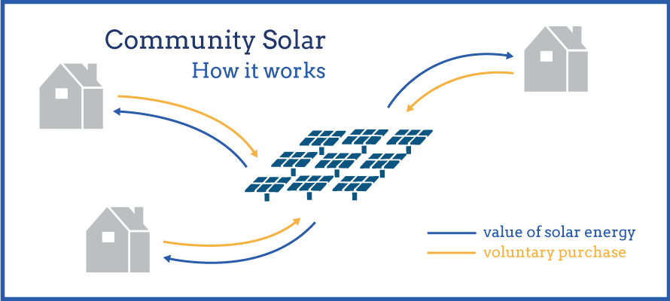
Community Solar
You can sell shares of a solar project to a commercial property
An alternative to commercial solar, or competing model

